Slide 1
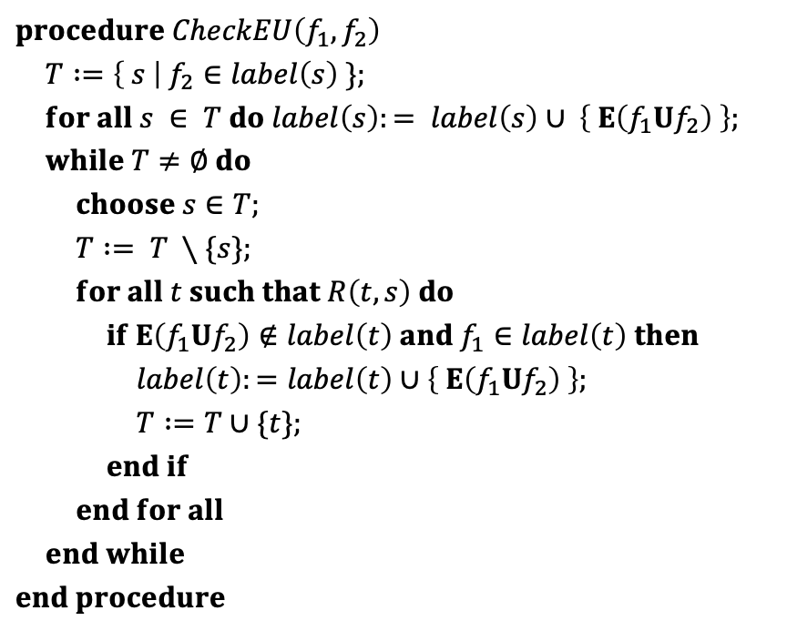
$$procedure CheckEU\left(f_{1},f_{2}\right)$$
$T :=\left\{ s \right| f_{2}∈label\left(s\right) \};$
$for all s ∈ T do label\left(s\right):= label\left(s\right)∪ \left\{ E\left(f_{1}Uf_{2}\right) \right\};$
$while T≠∅ do$
$choose s∈T;$
$T := T ∖\{s\};$ $for all t such that R\left(t,s\right) do$
$if E\left(f_{1}Uf_{2}\right)∉label\left(t\right) and f_{1}∈label\left(t\right) then$
$label\left(t\right):=label\left(t\right)∪\left\{ E\left(f_{1}Uf_{2}\right) \right\};$
$T :=T∪\{t\};$
$end if$
$end for all$
$end while$
$$end procedure$$

Slide 2
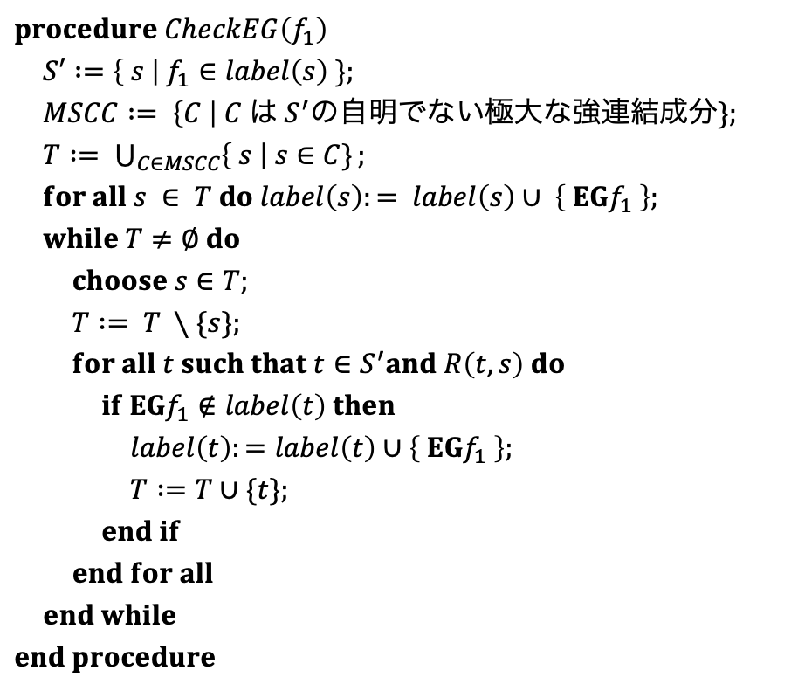
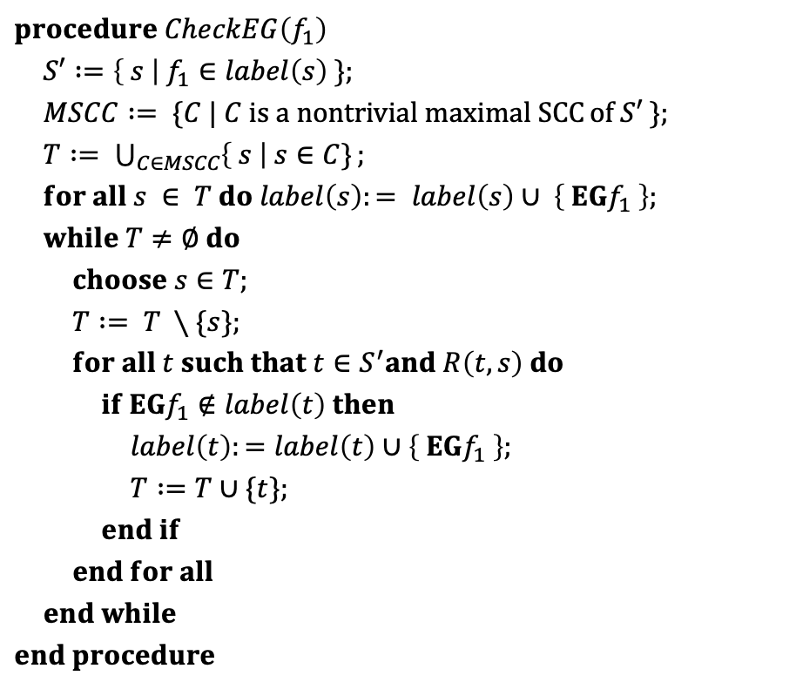
$$procedure CheckEG\left(f_{1}\right)$$
$S′ :=\left\{ s \right| f_{1}∈label\left(s\right) \};$
$MSCC := \{C | C is a nontrivial maximal SCC⁡of S′ \};$
$T := \bigcup_{C∈MSCC}{\left\{ s \right| s∈C\}};$ $for all s ∈ T do label\left(s\right):= label\left(s\right)∪ \left\{ EGf_{1} \right\};$
$while T≠∅ do$
$choose s∈T;$
$T := T ∖\{s\};$ $for all t such that t∈S^{′}and R\left(t,s\right) do$
$if EGf_{1}∉label\left(t\right) then$
$label\left(t\right):=label\left(t\right)∪\left\{ EGf_{1} \right\};$
$T :=T∪\{t\};$
$end if$
$end for all$
$end while$
$$end procedure$$
$$procedure CheckEG\left(f_{1}\right)$$
$S′ :=\left\{ s \right| f_{1}∈label\left(s\right) \};$
$MSCC := \left\{C \right| C は S^{′}\text{の自明}\text{でない極大な強連結成分}\};$
$T := \bigcup_{C∈MSCC}{\left\{ s \right| s∈C\}};$ $for all s ∈ T do label\left(s\right):= label\left(s\right)∪ \left\{ EGf_{1} \right\};$
$while T≠∅ do$
$choose s∈T;$
$T := T ∖\{s\};$ $for all t such that t∈S^{′}and R\left(t,s\right) do$
$if EGf_{1}∉label\left(t\right) then$
$label\left(t\right):=label\left(t\right)∪\left\{ EGf_{1} \right\};$
$T :=T∪\{t\};$
$end if$
$end for all$
$end while$
$$end procedure$$

Slide 3
1
~Start
~Close
~Heat
~Error
start oven
open door
close door
open door
cook
2
Start
~Close
~Heat
Error
3
~Start
Close
~Heat
~Error
4
~Start
Close
Heat
~Error
done
open door
close door
reset
start oven
start cooking
5
Start
Close
~Heat
Error
6
Start
Close
~Heat
~Error
7
Start
Close
Heat
~Error
warmup

Slide 4
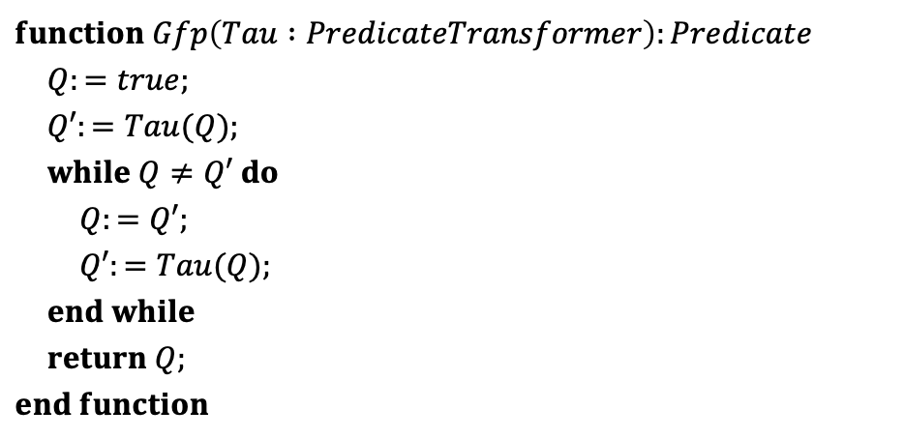
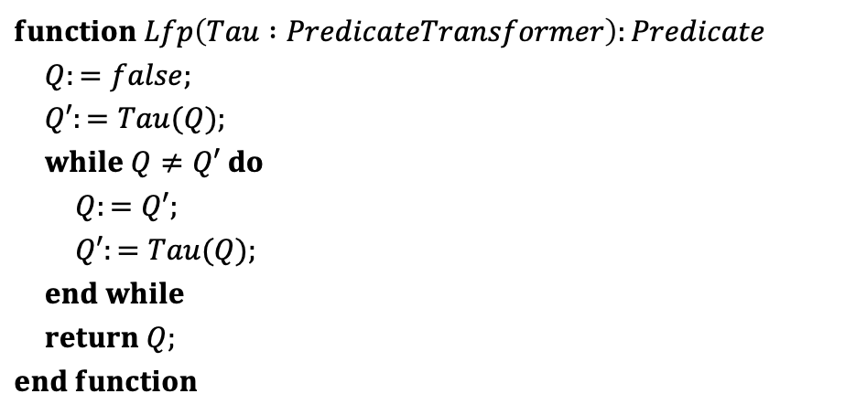
$$function Lfp\left(Tau :PredicateTransformer\right):Predicate$$
$Q:=false;$
$Q′:=Tau(Q);$
$while Q≠Q′ do$
$Q:=Q′;$
$Q′:=Tau(Q);$ $end while$
$return Q;$
$$end function$$
$$function Gfp\left(Tau :PredicateTransformer\right):Predicate$$
$Q:=true;$
$Q′:=Tau(Q);$
$while Q≠Q′ do$
$Q:=Q′;$
$Q′:=Tau(Q);$ $end while$
$return Q;$
$$end function$$

Slide 5



$$post\text{−}image(post\text{−}image\left(S_{0}\right))$$
$$post\text{−}image(S_{0})$$
$$S_{0}$$

Slide 6
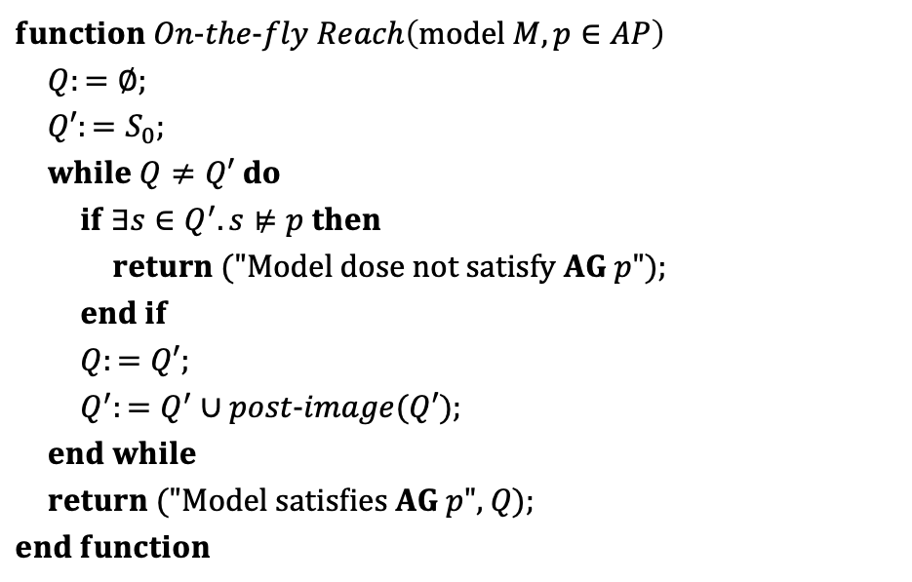
$$function On\text{−}the\text{−}fly Reach\left(\text{model} M, p∈AP\right)$$
$Q:=∅;$
$Q′:=S_{0};$
$while Q≠Q′ do$
$if ∃s∈Q^{′}.s⊭p then$
$return \text{(}\text{"}\text{Model} \text{dose} \text{not} \text{satisfy} AG p\text{"}\text{);}$
$end if$
$Q:=Q′;$
$Q^{′}:=Q^{′}∪post\text{−}image(Q′);$ $end while$
$return \text{("}\text{Model} \text{satisf}ies AG p\text{"}\text{, }Q\text{);}$
$$end function$$

Slide 7


















$$p$$
$$q$$
$$p$$
$$q$$
$$s0$$
$$p$$
$$s0$$
$$p$$
クリプキ構造
$$τ1(false)$$
$$p$$
$$q$$
$$p$$
$$q$$
$$s0$$
$$p$$
$$s0$$
$$p$$
$$τ2(false)$$
$$τ3(false)$$

Slide 8



















$$p$$
$$q$$
$$p$$
$$q$$
$$p$$
$$q$$
$$p$$
$$q$$
$$s0$$
$$p$$
$$s0$$
$$p$$
$$s0$$
$$p$$
$$s0$$
$$p$$
$$false$$
$$τ1(false)$$
$$τ2(false)$$
$$τ3(false)$$

Slide 9













































$$a_{1}$$
$$0$$
$$1$$
$$b_{1}$$
$$b_{1}$$
$$0$$
$$1$$
$$0$$
$$1$$
$$a_{2}$$
$$a_{2}$$
$$a_{2}$$
$$a_{2}$$
$$0$$
$$1$$
$$0$$
$$1$$
$$0$$
$$1$$
$$0$$
$$1$$
$$b_{2}$$
$$b_{2}$$
$$b_{2}$$
$$b_{2}$$
$$b_{2}$$
$$b_{2}$$
$$b_{2}$$
$$b_{2}$$
$$0$$
$$1$$
$$0$$
$$1$$
$$0$$
$$1$$
$$0$$
$$1$$
$$0$$
$$1$$
$$0$$
$$1$$
$$0$$
$$1$$
$$0$$
$$1$$
$$1$$
$$0$$
$$0$$
$$1$$
$$0$$
$$0$$
$$0$$
$$0$$
$$0$$
$$0$$
$$0$$
$$0$$
$$1$$
$$0$$
$$0$$
$$1$$

Slide 10

































$$a_{1}$$
$$a_{1}$$
$$0$$
$$1$$
$$0$$
$$1$$
$$b_{1}$$
$$b_{1}$$
$$a_{2}$$
$$a_{2}$$
$$1$$
$$1$$
$$0$$
$$0$$
$$1$$
$$0$$
$$1$$
$$a_{2}$$
$$b_{1}$$
$$0$$
$$b_{1}$$
$$b_{1}$$
$$b_{1}$$
$$1$$
$$0$$
$$0$$
$$0$$
$$1$$
$$1$$
$$0$$
$$b_{2}$$
$$b_{2}$$
$$0$$
$$1$$
$$1$$
$$1$$
$$0$$
$$0$$
$$b_{2}$$
$$b_{2}$$
$$1$$
$$0$$
$$0$$
$$0$$
$$1$$
$$1$$
$$1$$
$$1$$
$$0$$

Slide 11
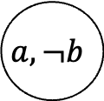
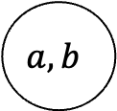


$$a,b$$
$$a,¬b$$
$$s1$$
$$s2$$

Slide 12
1
2
3
~h c
Xg
h c
Xg
~h ~c
Xg
4
h c
5
h ~c
Xg
6
~h c
7
~h ~c
8
h ~c

Slide 13
(3, 1)
(3, 2)
(1, 3)
(2, 4)
(1, 5)
(1, 5)
(2, 7)

Slide 14
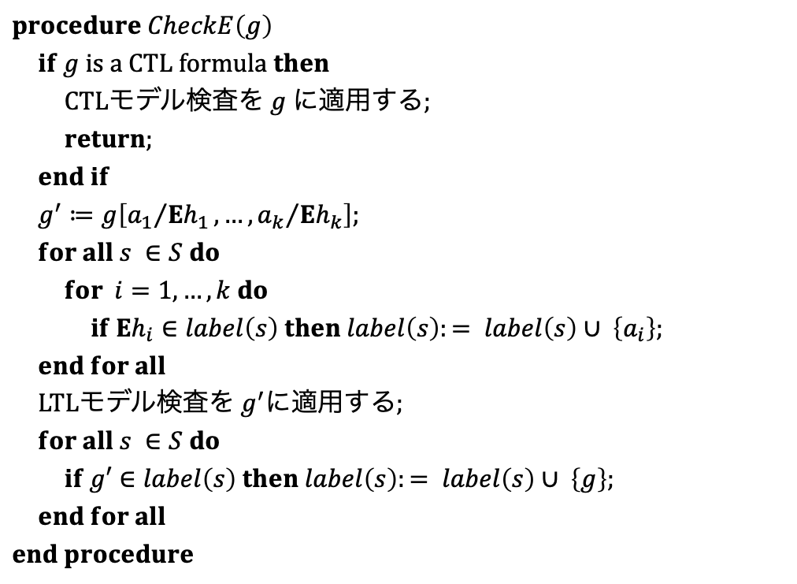
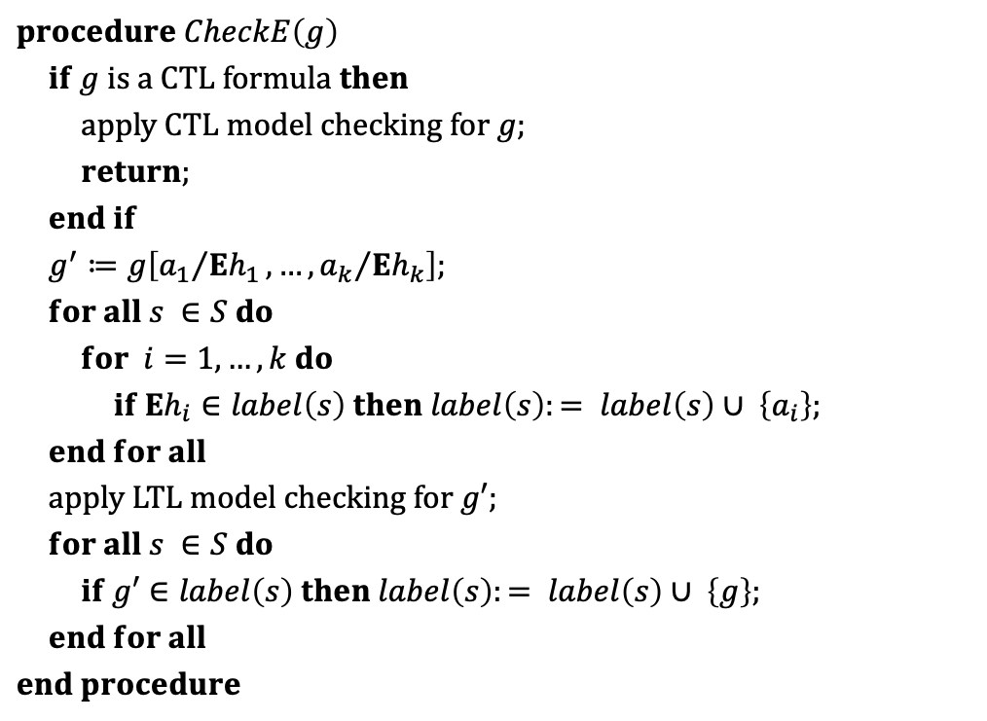
$$procedure CheckE\left(g\right)$$
$if g is a CTL formula then$
$apply CTL model checking for g;$
$return;$
$end if$
$g^{′}≔g\left[{a_{1}}/{Eh_{1}},…,{a_{k}}/{Eh_{k}}\right];$
$for all s ∈S do$
$for i=1,…,k do$
$if Eh_{i}∈label\left(s\right) then label\left(s\right):= label\left(s\right)∪ \left\{a_{i}\right\};$
$end for all$
$apply LTL model checking for g′;$
$for all s ∈S do$
$if g′∈label\left(s\right) then label\left(s\right):= label\left(s\right)∪ \left\{g\right\};$
$end for all$
$$end procedure$$
$$procedure CheckE\left(g\right)$$
$if g is a CTL formula then$
$CTLモデル検査を g に適用する;$
$return;$
$end if$
$g^{′}≔g\left[{a_{1}}/{Eh_{1}},…,{a_{k}}/{Eh_{k}}\right];$
$for all s ∈S do$
$for i=1,…,k do$
$if Eh_{i}∈label\left(s\right) then label\left(s\right):= label\left(s\right)∪ \left\{a_{i}\right\};$
$end for all$
$LTLモデル検査を g^{′}に適用する;$
$for all s ∈S do$
$if g′∈label\left(s\right) then label\left(s\right):= label\left(s\right)∪ \left\{g\right\};$
$end for all$
$$end procedure$$

Slide 15






$$x_{1}$$
$$0$$
$$1$$
$$x_{2}$$
$$1$$
$$0$$

Slide 16
















$${{\overline{x}}_{3}x}_{4}$$
$${\overline{x}}_{4}{\overline{x}}_{5}{\overline{x}}_{6}$$
$${{\overline{x}}_{5}x}_{6}$$
$$x_{1}=1$$
$$x_{4}=1$$
$${{\overline{x}}_{3}x}_{4}$$
$${\overline{x}}_{4}{\overline{x}}_{5}{\overline{x}}_{6}$$
$${\overline{x}}_{4}{\overline{x}}_{5}$$
$$κ$$
$$x_{3}=1$$
$${\overline{x}}_{4}{\overline{x}}_{5}{\overline{x}}_{6}$$
$${\overline{x}}_{3}{\overline{x}}_{5}$$
$$x_{5}=1$$
$${\overline{x}}_{4}{\overline{x}}_{5}{\overline{x}}_{6}$$
$${{\overline{x}}_{5}x}_{6}$$
$$x_{6}=1$$

Slide 17
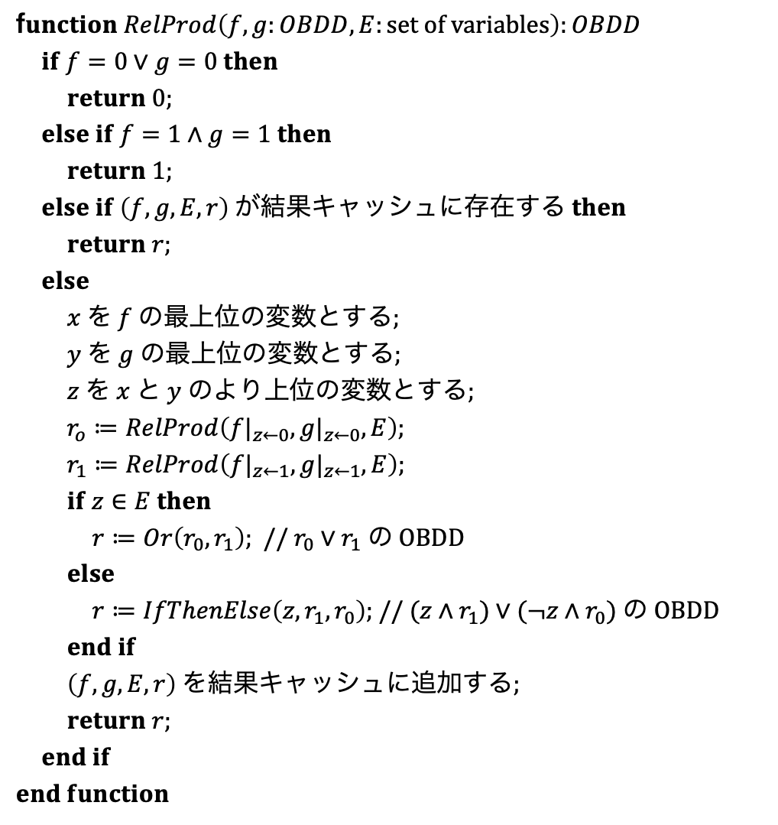
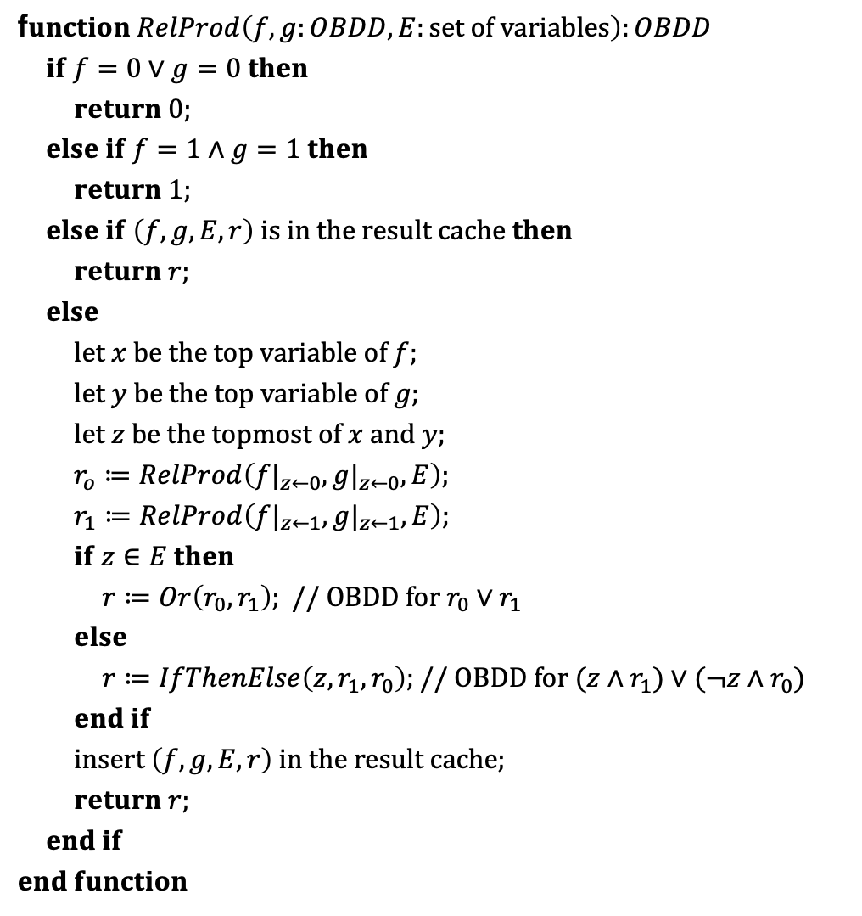
f$unction RelProd\left(f,g:OBDD, E:set of variables\right):OBDD$
$if f=0∨g=0 then$
$return 0;$
$else if f=1∧g=1 then$
$return 1;$
$else if \left(f,g,E,r\right) is in the result cache then$
$return r;$
$else$
$let x be the top variable of f;$
$let y be the top variable of g;$
$let z be the topmost of x and y;$
$r_{o}≔RelProd\left({f|}_{z←0},{g|}_{z←0},E\right);$
$r_{1}≔RelProd\left({f|}_{z←1},{g|}_{z←1},E\right);$
$if z∈E then$
$r≔Or\left(r_{0},r_{1}\right);$ // $OBDD for r_{0}∨r_{1}$
$else$
$r≔IfThenElse\left(z, r_{1},r_{0}\right);$ // $OBDD for (z∧r_{1})∨(¬z∧r_{0})$
$end if$
$insert \left(f, g, E, r\right) in the result cache;$
$return r;$
$end if$
$$end function$$
f$unction RelProd\left(f,g:OBDD, E:set of variables\right):OBDD$
$if f=0∨g=0 then$
$return 0;$
$else if f=1∧g=1 then$
$return 1;$
$else if \left(f,g,E,r\right) が結果キャッシュに存在する then$
$return r;$
$else$
$x を f の最上位の変数とする;$
$y を g の最上位の変数とする;$
$z を x と y のより上位の変数とする;$
$r_{o}≔RelProd\left({f|}_{z←0},{g|}_{z←0},E\right);$
$r_{1}≔RelProd\left({f|}_{z←1},{g|}_{z←1},E\right);$
$if z∈E then$
$r≔Or\left(r_{0},r_{1}\right);$ // $r_{0}∨r_{1} の OBDD$
$else$
$r≔IfThenElse\left(z, r_{1},r_{0}\right);$ // $(z∧r_{1})∨(¬z∧r_{0}) の OBDD$
$end if$
$\left(f, g, E, r\right) を結果キャッシュに追加する;$
$return r;$
$end if$
$$end function$$

Slide 18













$$s$$
$$s$$
SCC 1
SCC 1
$$t$$
$$t$$
$$P_{2}$$
$$P_{1}$$
$$P_{2}$$
$$s′$$
SCC 2
$$P_{1}$$
$$s′$$
SCC 3
$$t′$$
$$P_{1}$$
$$P_{2}$$
$$s′′$$

Slide 19













$$P_{2}$$
$$s$$
$$t$$
$$P_{1}$$
$$s′$$
SCC 1
$$P_{2}$$
$$P_{2}$$
$$P_{1}$$
$$s$$
$$t$$
$$s′$$
$$t′$$
$$P_{1}$$
$$s′′$$
SCC 1
SCC 2
SCC 3

Slide 20
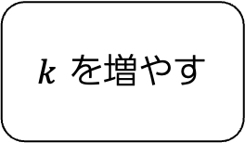
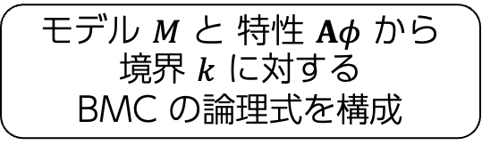
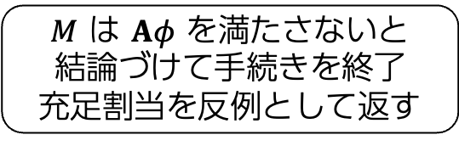
モデル $M$ と 特性 $Aφ$ から
境界 $k$ に対する
BMC の論理式を構成
この論理式は
充足可能か？
UNSAT
(充足不能)
SAT
(充足可能)
$k$ を増やす
$M$ は $Aφ$ を満たさないと
結論づけて手続きを終了
充足割当を反例として返す

Slide 21





















































…
$$¬p$$
$$p$$
$$p$$
$$p$$
…
$$p$$
$$¬p$$
$$s_{0}$$
$$s_{1}$$
$$s_{2}$$
$$s_{k−1}$$
$$s_{k}$$
$$s_{0}$$
$$s_{1}$$
$$s_{2}$$
$$s_{k−1}$$
$$s_{k}$$
$$00$$
$$10$$
$$01$$
$$11$$
$$1$$
$$2$$
$$3$$
$$4$$
$$5$$
$$a$$
$$a$$
$$a$$
$$b$$
$$p,q$$
$$p,q$$
$$p,q$$
$$q$$
…
$$6$$
$$7$$
$$q$$
$$π_{0}$$
$$π_{1}$$
$$π_{1}$$
$$¬p$$
$$¬p$$
$$¬p$$
…
$$¬p$$
$$¬p$$
…
$$¬p$$
$$¬p$$
$$s_{0}$$
$$s_{1}$$
$$s_{2}$$
$$s_{l−1}$$
$$s_{l}$$
$$s_{k−2}$$
$$s_{k−1}$$

Slide 22

$$p$$

